Slide 1
Deep Learning
By Jiten Sahoo

Slide 2
What is Deep Learning
Deep learning is a subset of machine learning, which is essentially a neural network with three or more layers. These neural networks attempt to simulate the behavior of the human brain—albeit far from matching its ability—allowing it to “learn” from large amounts of data.

Slide 3
Perceptron
Perceptron is also understood as an Artificial Neuron or neural network unit that helps to detect certain input data computations in business intelligence.
Perceptron model is also treated as one of the best and simplest types of Artificial Neural networks. However, it is a supervised learning algorithm of binary classifiers. Hence, we can consider it as a single-layer neural network with four main parameters, i.e., input values, weights and Bias, net sum, and an activation function.

Slide 4
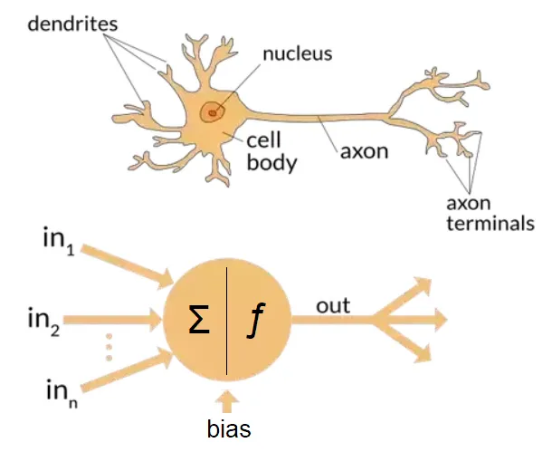
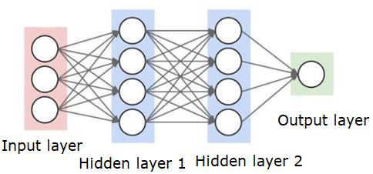
Biological vs Artificial Neuron

Slide 5
The dendrite is where a neuron receives input from other neurons.
The axon is the output of a neuron it transmits the signal to other neurons.
The cell body contains a nucleus and genetic material, which controls the cell’s activities.

Slide 6
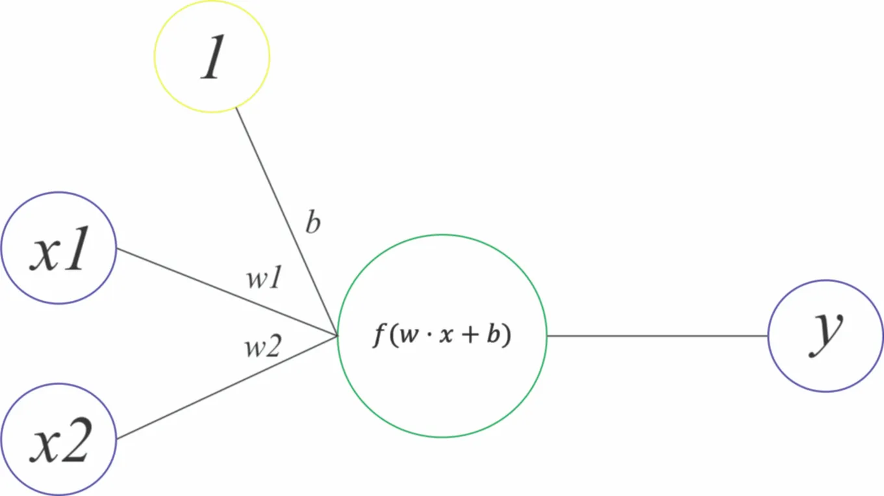
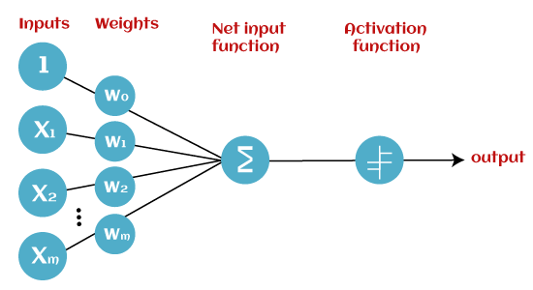
Basic Components of Perceptron

Slide 7
Input Nodes or Input Layer:
This is the primary component of Perceptron which accepts the initial data into the system for further processing. Each input node contains a real numerical value.
Wight and Bias:
Weight parameter represents the strength of the connection between units. This is another most important parameter of Perceptron components. Weight is directly proportional to the strength of the associated input neuron in deciding the output. Further, Bias can be considered as the line of intercept in a linear equation.
Activation Function:
These are the final and important components that help to determine whether the neuron will fire or not. Activation Function can be considered primarily as a step function.
Types of Activation functions:
Sign function
Step function, and
Sigmoid function
RELU

Slide 8
How does Perceptron work?
Single Layer Perceptron model:
One of the easiest ANN(Artificial Neural Networks) types consists of a feed-forward network and includes a threshold transfer inside the model. The main objective of the single-layer perceptron model is to analyze the linearly separable objects with binary outcomes. A Single-layer perceptron can learn only linearly separable patterns .
2. Multi-Layered Perceptron model:
It is mainly similar to a single-layer perceptron model but has more hidden layers.

Slide 9
Advantages:
A multi-layered perceptron model can solve complex non-linear problems.
It works well with both small and large input data.
Helps us to obtain quick predictions after the training.
Helps us obtain the same accuracy ratio with big and small data.
Disadvantages:
In multi-layered perceptron model, computations are time-consuming and complex.
It is tough to predict how much the dependent variable affects each independent variable.
The model functioning depends on the quality of training.

Slide 10
Limitation of Perceptron Model
The following are the limitation of a Perceptron model:
The output of a perceptron can only be a binary number (0 or 1) due to the hard-edge transfer function.
It can only be used to classify the linearly separable sets of input vectors. If the input vectors are non-linear, it is not easy to classify them correctly.

Slide 11
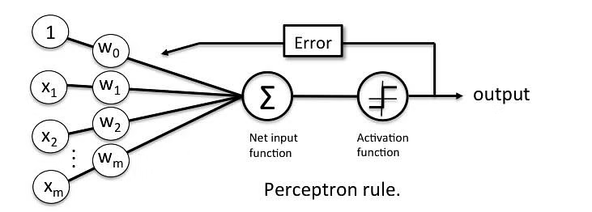
Perceptron Learning Rule

Slide 12
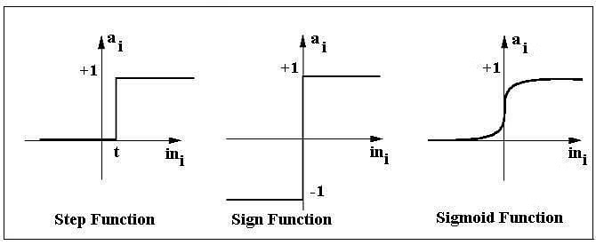
Activation Functions of Perceptron

Slide 13
Why do we need Non-linear activation function?
A neural network without an activation function is essentially just a linear regression model. The activation function does the non-linear transformation to the input making it capable to learn and perform more complex tasks.

Slide 14
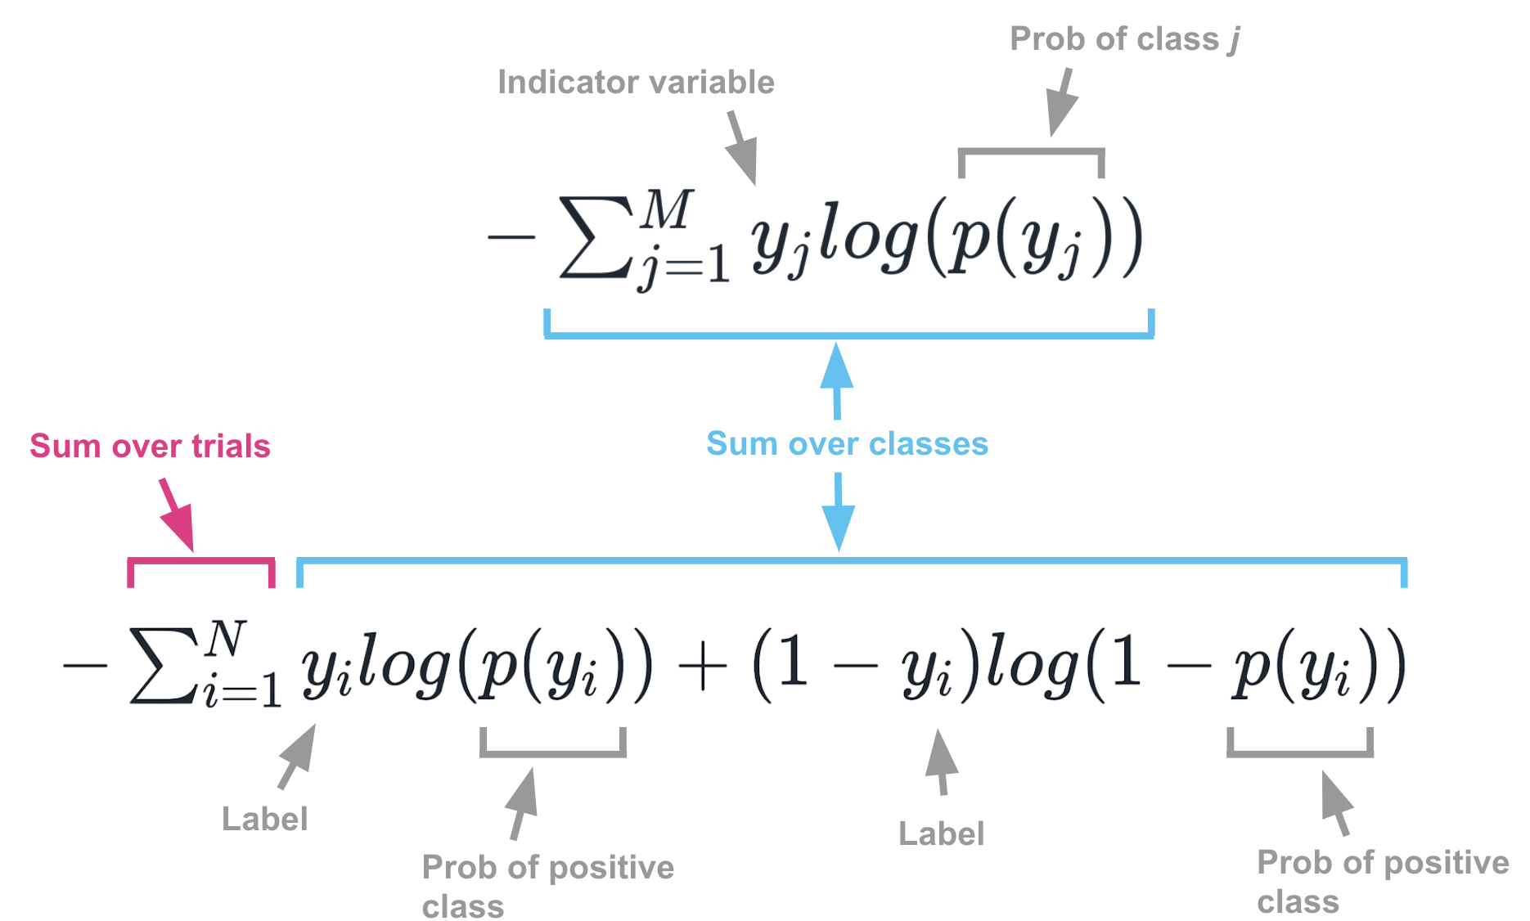
Regression:
Loss Function: Mean Squared Error (MSE).
Classification :
Cross-Entropy, also referred to as Logarithmic loss.

Slide 15
Types of Activation Function
Sigmoid
Tanh
RELU
Softmax ( for multiple classification)

Slide 16
Back Propagation
Backpropagation is the essence of neural network training. It is the method of fine-tuning the weights of a neural network based on the error rate obtained in the previous epoch (i.e., iteration). Proper tuning of the weights allows you to reduce error rates and make the model reliable by increasing its generalization.

Slide 17
How it works
Backpropagation is fast, simple and easy to program
It has no parameters to tune apart from the numbers of input
It is a flexible method as it does not require prior knowledge about the network
It is a standard method that generally works well
It does not need any special mention of the features of the function to be learned.

Slide 18

Static back-propagation:
It is one kind of backpropagation network which produces a mapping of a static input for static output. It is useful to solve static classification issues like optical character recognition.
Recurrent Backpropagation:
Recurrent Back propagation in data mining is fed forward until a fixed value is achieved. After that, the error is computed and propagated backward.

Slide 19
Steps of Training a Neural Network
Training a neural network consists of the following basic steps:
Step-1: Initialization of Neural Network: Initialize weights and biases.
Step-2: Forward propagation: Using the given input X, weights W, and biases b, for every layer we compute a linear combination of inputs and weights (Z)and then apply activation function to linear combination (A). At the final layer, we compute f(A^{(l-1)}) which could be a sigmoid (for binary classification problem), softmax (for multi-class classification problem), and this gives the prediction y_hat.
Step-3: Compute the loss function: The loss function includes both the actual label y and predicted label y_hat in its expression. It shows how far our predictions from the actual target, and our main objective is to minimize the loss function.
Step-4: Backward Propagation: In backpropagation, we find the gradients of the loss function, which is a function of y and y_hat, and gradients wrt A, W, and b called dA, dW, and db. By using these gradients, we update the values of the parameters from the last layer to the first layer.
Step-5: Repeat steps 2–4 for n epochs till we observe that the loss function is minimized, without overfitting the train data.

Slide 20
Weight Initialization
Zero Initialization
Random Initialization

Slide 21
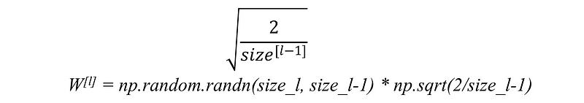
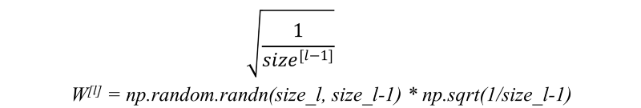
For RELU activation function: This heuristic is called He-et-al Initialization
For tanh activation function : This heuristic is known as Xavier initialization.

Slide 22
Introduction to Tensorflow and Keras
Keras is based on minimal structure that provides a clean and easy way to create deep learning models based on TensorFlow or Theano. Keras is designed to quickly define deep learning models. Well, Keras is an optimal choice for deep learning applications.
Features
Keras leverages various optimization techniques to make high level neural network API easier and more performant. It supports the following features −
Consistent, simple and extensible API.
Minimal structure - easy to achieve the result without any frills.
It supports multiple platforms and backends.
It is user friendly framework which runs on both CPU and GPU.
Highly scalability of computation.

Slide 23
Vanishing and Exploding Gradient Problem
When there are more layers in the network, the value of the product of derivative decreases until at some point the partial derivative of the loss function approaches a value close to zero, and the partial derivative vanishes. We call this the vanishing gradient problem.
In a network with vanishing gradient, the weights cannot be updated, so the network cannot learn. The performance of the network will decrease as a result. SIgmoid function provides very less change in updating weights.
Method to overcome the problem The vanishing gradient problem is caused by the derivative of the activation function used to create the neural network. The simplest solution to the problem is to replace the activation function of the network. Instead of sigmoid, use an activation function such as ReLU.

Slide 24
Exploding Gradient Prob
On some cases, the gradients keep on getting larger and larger as the backpropagation algorithm progresses. This, in turn, causes very large weight updates and causes the gradient descent to diverge. This is known as the exploding gradients problem.
We know that derivative of sigmoid function varies from 0 to 0.25.
If we increase the weight , then the updated weight will be much higher that previous weight.

Slide 25
Regularization
Regularization refers to a set of different techniques that lower the complexity of a neural network model during training, and thus prevent the overfitting.
There are three very popular and efficient regularization techniques called L1, L2, and dropout which we are going to discuss in the following.

Slide 26
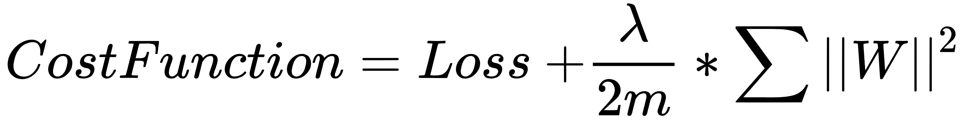
L2 regularization

Slide 27
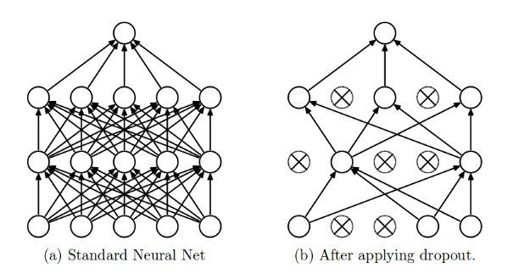
Drop Out layer

Slide 28
Early Stopping
Early stopping is a method that allows you to specify an arbitrary large number of training epochs and stop training once the model performance stops improving on a hold out validation dataset.

Slide 29
Optimizers
SGD ( stochastic gradient descent)
Mini Batched GD
AdaGrad
AdaDelta
RMSProp
ADAM

Slide 30
Stochastic Gradient Descent (SGD)
Stochastic Gradient Descent is an extension of Gradient Descent, where it overcomes some of the disadvantages of Gradient Descent algorithm. SGD tries to overcome the disadvantage of computationally intensive by computing the derivative of one point at a time. Due to this fact, SGD takes more number of iterations compared to GD to reach minimum and also contains some noise when compared to Gradient Descent. As SGD computes derivatives of only 1 point at a time, the time taken to complete one epoch is large compared to Gradient Descent algorithm.

Slide 31
Mini Batch — Stochastic Gradient Descent
MB-SGD is an extension of SGD algorithm. It overcomes the time-consuming complexity of SGD by taking a batch of points / subset of points from dataset to compute derivative.

Slide 32
Momentum based Optimizer
It is an adaptive optimization algorithm which exponentially uses weighted average gradients over previous iterations to stabilize the convergence, resulting in quicker optimization. This is done by adding a fraction (gamma) to the previous iteration values. Essentially the momentum term increase when the gradient points are in the same directions and reduce when gradients fluctuate. As a result, the value of loss function converges faster than expected.

Slide 33
AdaGrad
Adaptive Gradient as the name suggests adopts the learning rate of parameters by updating it at each iteration depending on the position it is present, i.e- by adapting slower learning rates when features are occurring frequently and adapting higher learning rate when features are infrequent.

Slide 34
HyperParameter Tuning
We use Keras tuner library for tuning model.
Basically we are concentrating on number of hidden layers, number of neurons and learning rate.

